Slide 1

DriverPass System Analysis
Dominic Caulfield Duverger
Notes:
[No speaker notes required for this slide.]

Slide 2

System Requirements
The client, DriverPass, has requested that the system is capable of:
Being efficient and web-based, as it should be accessible from most devices
Be able to update the information entered on the website in near live time
Provide users with a dashboard to get an overview of their account
Provide the instructor with an offline version of a customer's dashboard to add notes and completion progress to when an internet connection is unavailable
Notes:
The non-functional requirements are that the system is web based, efficient, and the data should be updated as new data is added or removed in near live time, by saving the changes after they are entered into the website.
The functional requirements include the ability to provide users with a dashboard, which includes their personal information (name, address, photo), an image and name of their instructor (if applicable), a overview of their progress, notes made by the instructor, and a quick overview of their scheduled appointments. The other functional requirement is for providing instructors with the ability to download an offline version of the dashboard to then update while offline if connection is spotty, allowing the instructor to upload when internet connection is good.

Slide 3
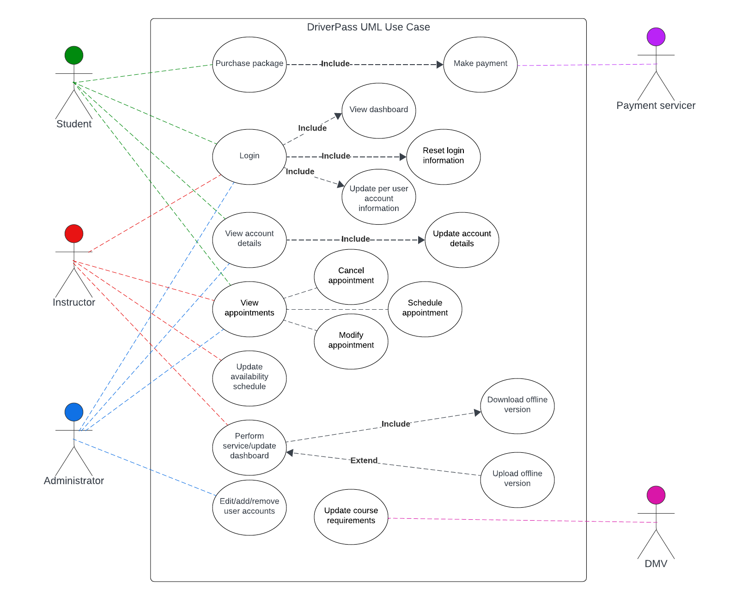
Use Case Diagram
Notes:
The primary users of the system include the students, instructors, and administrators. They all have the ability to access their account and dashboard, along with editing their account, and the ability to view appointments. Along with the general dashboard access, the administrators have the ability to view specific account details for all users. They can also edit, delete, and add user accounts. They can view all appointments and update them as required The instructors have the ability to perform services in the system, view the services required, download an offline version of the dashboard/services, and upload the offline version again. They also can update their availability on the calendar and view appointments with the students assigned to them, and schedule them as needed. Students have the ability to view their own appointment only, cancel appointments, modify appointments, and schedule appointments based on availability. They can also add a package to their account and make a payment. This brings up another required actor, a payment servicer, who deals with the back-end of the payment system and will process payments. The final actor is the DMV, who will send updated data to automatically change requirements for driving instructors to go over in their service to the student.

Slide 4
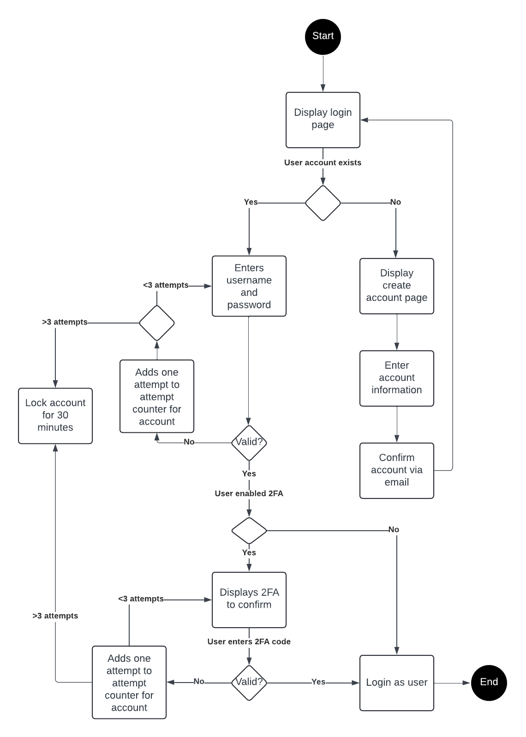
Activity Diagram
Notes:
This use case is for the log in process. The user first has to be on the login page for the website, where if the user does not have an account they would click on a create account button which forwards them to a create account page, they enter the required information which would include name, email, username, password for basic account creation, and then would need to confirm their account via an email sent. Once these steps are completed, the user would enter username and password and click log in, where the credentials are checked to be valid. If the credentials are invalid, the system would add a new attempt for failed attempts, and forward to the login page where the user can enter their credentials again. The user is given 3 attempts until the account is locked for 30 minutes. If the credentials are valid, the system then checks if the user has 2 Factor Authentication enabled, which if enabled will prompt the user for a code provided via an authenticator app, email, or text. If this is entered incorrectly, the user once again has 3 attempts, which after the 3rd failed attempt the account is locked for 30 minutes. If correct, the user is then sent to their accounts dashboard, the same is done if the user has not enabled 2 factor authentication and their username and password were correct.

Slide 5
Security
The main security features that will be noticed by users are on the account level, where there are a set amount of attempts that can be made to log in, 3 to be specific, until the account is locked.
There is the ability to set up 2 factor authentication for the users
On the back end of the system, there will be a couple systems in place to protect data
A firewall
A security software
Notes:
[How did you consider security in your design? In your explanation, keep your audience in mind by avoiding the use of technical terms.]
Based on the requirements for the system, the most likely vulnerabilities of the system are on the user side of the system, so focusing on those is the best option. Limiting users to a few incorrect attempts at logging in within a set period of time is a good deterrence to anyone trying to force their way onto a user's account. Adding 2 factor authentication is another deterrence, and is highly recommended for everyone to set up, especially administrators who have more access. The back-end of the security would be on the server side, where a software would be able to handle most of the systems security, as the customer requests to be as hands off as possible. A dedicated firewall would add another line of defence as well.

Slide 6
System Limitations
The primary limitations to the system include:
The potential of the user not having access to the internet
The potential of the user not having a modern enough device to access the website
The limited vehicles available to be driven at a time
Notes:
[What are the limitations of your design? In your explanation, keep your audience in mind by avoiding the use of technical terms.]
The limitations are easy to understand, they are simple and basic limitations. Part of the first limitation, the potential of a user not having internet access, is solved for the instructor as they can download an offline version of the dashboard to update and then upload to the system. The potential of a user not having a modern enough device is highly unlikely, but not impossible, due to the basic security features of websites. The limit of vehicles can be solved, but is a costly solution and would likely be done when scaling the business further.

